Slide 1




Data Structures Efficiency
Computational Complexity of Fundamental Data Structures Choosing a Data Structure
Efficiency
SoftUni Team
Technical Trainers
Software University
http://softuni.bg

Slide 2

Table of Contents
Classical Collection Data Structures – Comparison
Arrays, Lists, Stacks, Queues
Hash-Table-Based Collections
Dictionaries, Multi-Dictionaries, Sets, Bags
Balanced Search Tree-Based Collections
Sorted Dictionaries and Multi-Dictionaries, Sorted Sets and Sorted Bags
Choosing a Collection Data Structure
Special Data Structures and Their Efficiency
Combining Data Structures

Slide 3

Comparing Data Structures
Computational Complexity of Basic Operations

Slide 4
Data Structure Efficiency – Comparison
Data Structure | Add | Find | Delete | Get-by-index
Static array: T[] | O(n) | O(n) | O(n) | O(1)
Double-linked list: LinkedList<T> | O(1) | O(n) | O(n) | O(n)
Auto-resizable array-based list: List<T> | O(1) | O(n) | O(n) | O(1)
Stack: Stack<T> | O(1) | - | O(1) | -
Queue: Queue<T> | O(1) | - | O(1) | -

Slide 5
Data Structure Efficiency – Comparison (2)
Data Structure | Add | Find | Delete | Get-by-index
Hash-table: Dictionary<K,V> | O(1) | O(1) | O(1) | -
Balanced tree-based dictionary: SortedDictionary<K,V> | O(log n) | O(log n) | O(log n) | -
Hash-table-based set: HashSet<T> | O(1) | O(1) | O(1) | -
Balanced tree-based set: SortedSet<T> | O(log n) | O(log n) | O(log n) | -

Slide 6
Data Structure Efficiency – Comparison (3)
Data Structure | Add | Find | Delete | Get-by-index
Hash-table-based multi-dictionary: MultiDictionary<K,V> | O(1) | O(1) | O(1) | -
Tree-based multi-dictionary: SortedDictionary<K,V> | O(log n) | O(log n) | O(log n) | -
Hash-table-based bag: Bag<T> | O(1) | O(1) | O(1) | -
Balanced tree-based bag: OrderedBag<T> | O(log n) | O(log n) | O(log n) | -

Slide 7
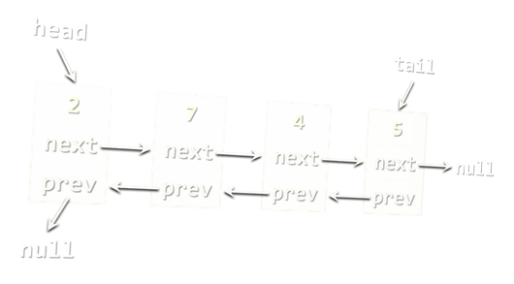
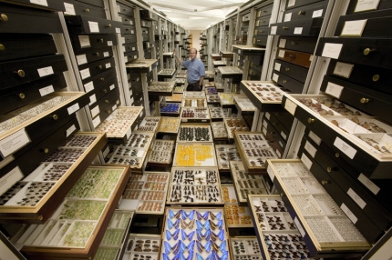
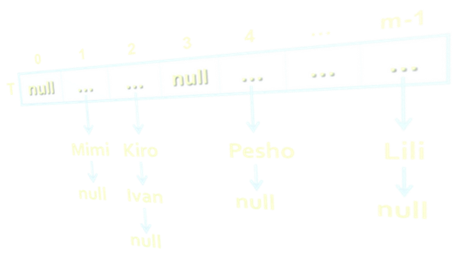
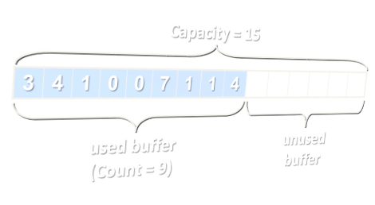
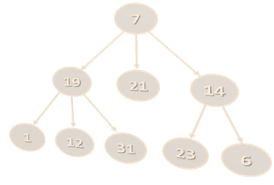
Choosing a Collection Data Structure
Lists vs. Dictionaries vs. Balanced Trees

Slide 8
Choosing a Collection Data Structure
Array (T[])
Use when fixed number of elements should be processed by index
No resize → for fixed number of elements only
Add / delete needs creating a new array + move O(n) elements
Resizable array-based list (List<T>)
Use when elements should be fast added and processed by index
Add (append to the end) has O(1) amortized complexity
The most-often used collection in programming

Slide 9
Choosing a Collection Data Structure (2)
Doubly-linked list (LinkedList<T>)
Use when elements should be added at the both sides of the list
Otherwise use resizable array-based list (List<T>)
Stack (Stack<T>)
Use to implement LIFO (last-in-first-out) behavior
List<T> could also work well
Queue (Queue<T>)
Use to implement FIFO (first-in-first-out) behavior
LinkedList<T> could also work well

Slide 10
Choosing a Collection Data Structure (3)
Hash-table-based dictionary (Dictionary<K,V>)
Fast add key-value pairs + fast search by key – O(1)
Elements in a hash-table have no particular order
Keys should implement correctly GetHashCode(…) and Equals(…)
Balanced tree-based dictionary (OrderedDictionary<K,V>)
Elements are ordered by key (foreach returns the elements sorted)
Fast add key-value pairs + fast search by key + fast sub-range
Keys should implement correctly IComparable<T>
Balanced trees are slightly slower than hash-tables: O(log n) vs. O(1)

Slide 11
Choosing a Collection Data Structure (4)
Hash-table-based multi-dictionary (MultiDictionary<K,V>)
Fast add key-value pairs + fast search by key + multiple values by key
Add by existing key appends a new value for the same key
Keys in a hash table have no particular order
Balanced tree-based multi-dictionary (OrderedMultiDictionary<K,V>)
Keys are ordered by key (foreach returns the elements sorted)
Fast add key-value pairs + fast search by key + fast sub-range
Add by existing key appends a new value for the same key

Slide 12
Choosing a Collection Data Structure (5)
Hash-table-based set (HashSet<T>)
Keep unique values + fast add + fast check membership to the set
Elements in the set have no particular order
Elements should implement GetHashCode(…) and Equals(…)
Balanced tree-based set (SortedSet<T>)
Keep unique values, sorted internally
Fast add + fast check membership to the set + fast sub-range
Elements should implement correctly IComparable<T>

Slide 13
Choosing a Collection Data Structure (6)
Hash-table-based bag (Bag<T>)
Bags are multi-sets (allow duplicates / count occurrences)
Fast add / find / check membership
Elements have no particular order
Balanced tree-based bag (SortedBag<T>)
Keep non-unique elements, sorted internally
Fast add / find / check membership
Fast access by sorted index / extract sub-range

Slide 14
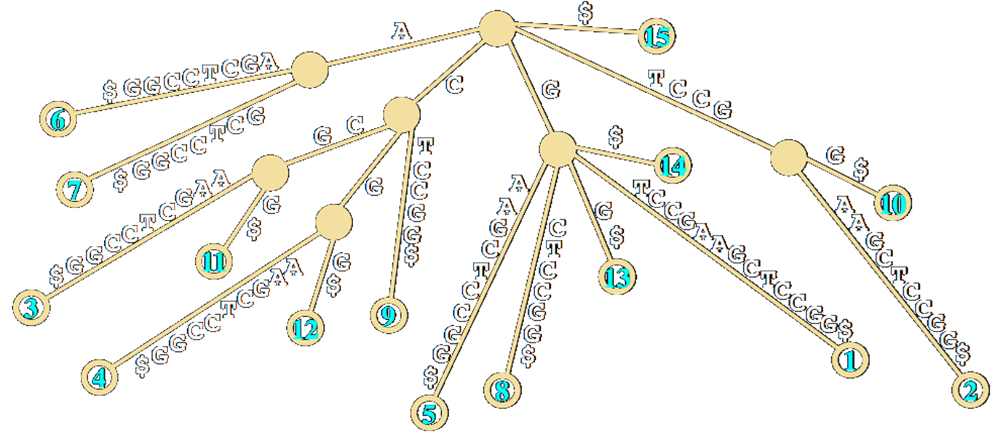
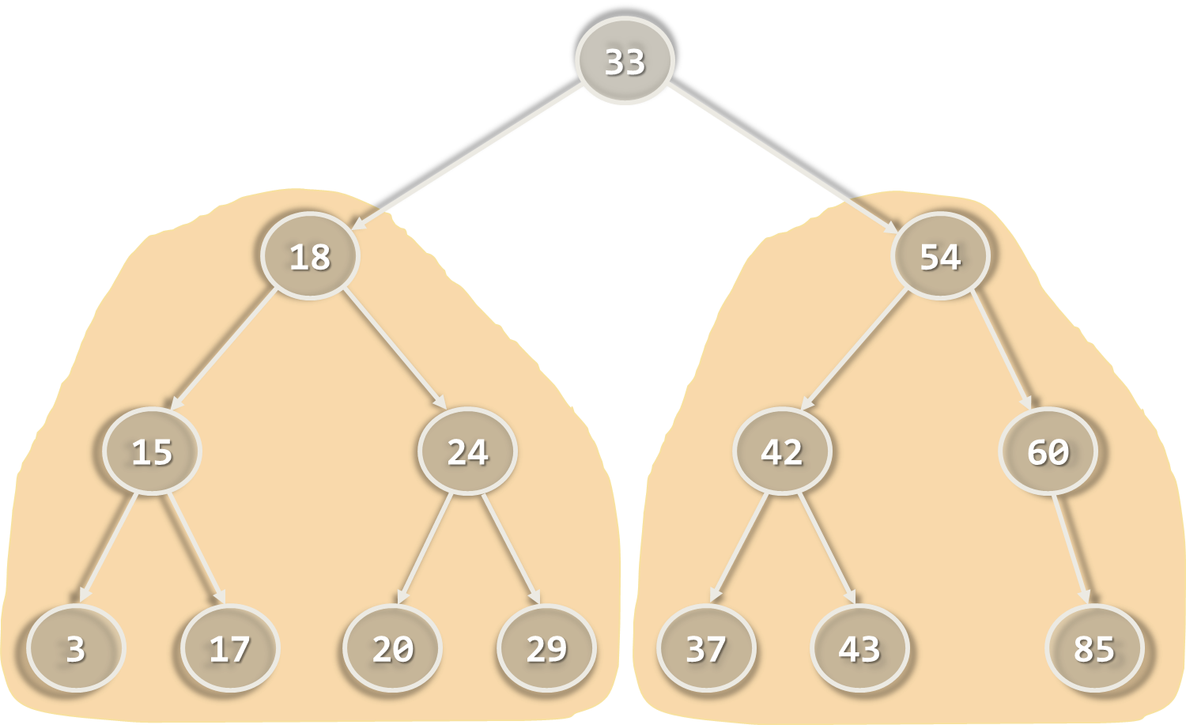
Special Data Structures and Their Efficiency

Slide 15

Special Data Structures and Efficiency
Rope (BigList<T>)
Holds a editable, ordered, indexed sequence of items
The order of added items is preserved
Like List<T>, but allows fast insert / delete
Append(item), Insert(index, item) – O(log n)
Item[index] – access by index – O(log n)
Delete(index) – O(log n)
Sub-list(start, end) with copy-on-change – O(log n)

Slide 16
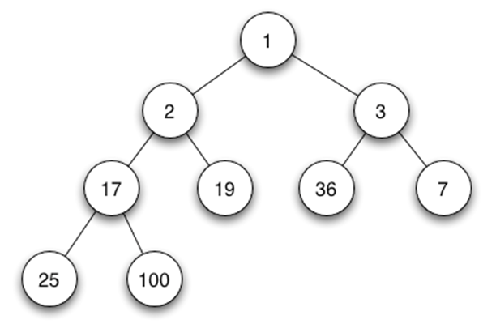
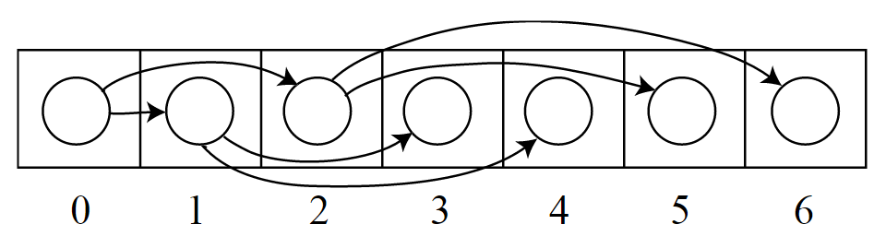
Special Data Structures and Efficiency (2)
Binary heap (BinaryHeap<T>)
Efficient implementation of priority queue
Insert(item) – O(log n)
Delete-Min – O(log n)
Find-Min – O(1)

Slide 17


The Art and Science of Combining Data Structures

Slide 18
Combining Data Structures
In many scenarios we need to combine several data structures
No single data structure can provide good running times for certain combination of operations
For example, we can combine:
A hash-table for fast search by key₁ (e.g. name)
A hash-table for fast search by {key₂ + key₃} (e.g. name + town)
A balanced search tree for fast extract-range(start_key … end_key)
A rope for fast access-by-index
A balanced search tree for fast access-by-sorted-index

Slide 19
Combining Data Structures – Example
Design a data structure that efficiently implements:
Add-Person(email, name, age, town) – the email is unique
If the email already exists returns false, otherwise true
Find-Person(email) – returns the Person object or null
Delete-Person(email) – returns true or false
Find-People(email_domain) – returns collection sorted by email
Find-People(name, town) – returns collection sorted by email
Find-People(start_age, end_age) – sort results by age, then by email
Find-People(start_age, end_age, town) – sort by age + email

Slide 20
Implementing a Combined Data Structure
Add-Person(email, name, age, town) – O(log n)
Create a Person object to hold { email + name + age + town }
Add the new person to all underlying data structures
Find-Person(email) – O(1)
Use a hash-table to map { email → person }
Delete-Person(email) – O(log n)
Find the person by email in the underlying hash-table
Delete the person from all underlying data structures

Slide 21
Implementing a Combined Data Structure (2)
Find-People(email_domain) – O(1)
Use a hash-table to map {email_domain → SortedSet<Person>}
The set of persons for each domain is internally ordered by email
The email_domain is extracted by the email when adding persons
Find-People(name, town) – O(1)
Combine the keys {name + town} into a single string name_town
Use a hash-table to map {name_town → SortedSet<Person>}
The set of persons for each domain is internally ordered by email

Slide 22
Implementing a Combined Data Structure (3)
Find-People(start_age, end_age) – O(log n)
Use a balanced search tree to keep all persons ordered by age: OrderedDictionary<age, SortedSet<Person>>
For each distinct age keep a set of persons, ordered by email
Use the sub-range(start_age, end_age) operation in the tree
Find-People(start_age, end_age, town) – O(log n)
Use a hash-table to map {town → persons_by_ages}
People_by_ages can be stored as balanced search tree: OrderedDictionary<age, SortedSet<Person>>

Slide 23

Lab Exercise
Collection of People

Slide 24

Summary
Different data structures have different efficiency for their operations
List-based collections provide fast append and access-by-index, but slow find and delete
The fastest add / find / delete structure is the hash table – O(1) for all operations
Balanced trees are ordered – O(log n) for add / find / delete + range(start, end)
Combining data structures is often essential
E.g. combine multiple hash-tables to find by different keys

Slide 25









Data Structures Efficiency
https://softuni.bg/trainings/1147/Data-Structures-June-2015

Slide 26
License
This course (slides, examples, labs, videos, homework, etc.) is licensed under the "Creative Commons Attribution-NonCommercial-ShareAlike 4.0 International" license
Attribution: this work may contain portions from
"Fundamentals of Computer Programming with C#" book by Svetlin Nakov & Co. under CC-BY-SA license
"Data Structures and Algorithms" course by Telerik Academy under CC-BY-NC-SA license

Slide 27






Free Trainings @ Software University
Software University Foundation – softuni.org
Software University – High-Quality Education, Profession and Job for Software Developers
softuni.bg
Software University @ Facebook
facebook.com/SoftwareUniversity
Software University @ YouTube
youtube.com/SoftwareUniversity
Software University Forums – forum.softuni.bg

